Slide 1
DAC (Disctrict Advisory Committee) Screen Mockups

Slide 2
Roles
Admin
Principal and DAC_SC
Campus based employees
Central Office employees

Slide 3
Admin screens

Slide 4
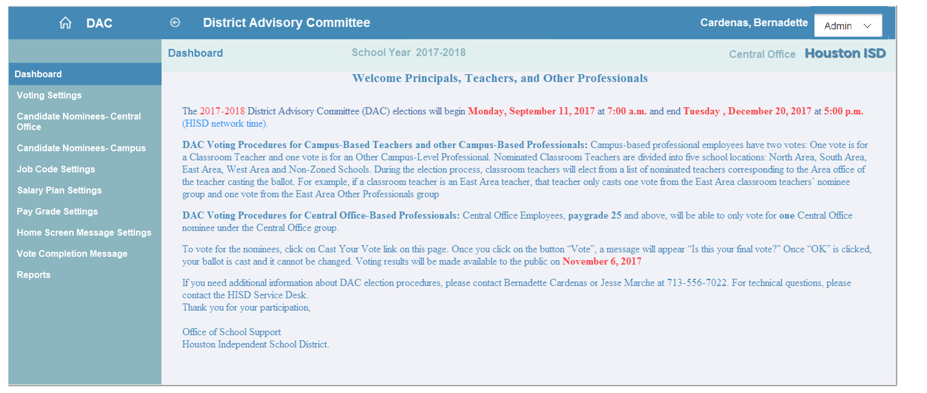
Admin Screen- Dashboard

Slide 5
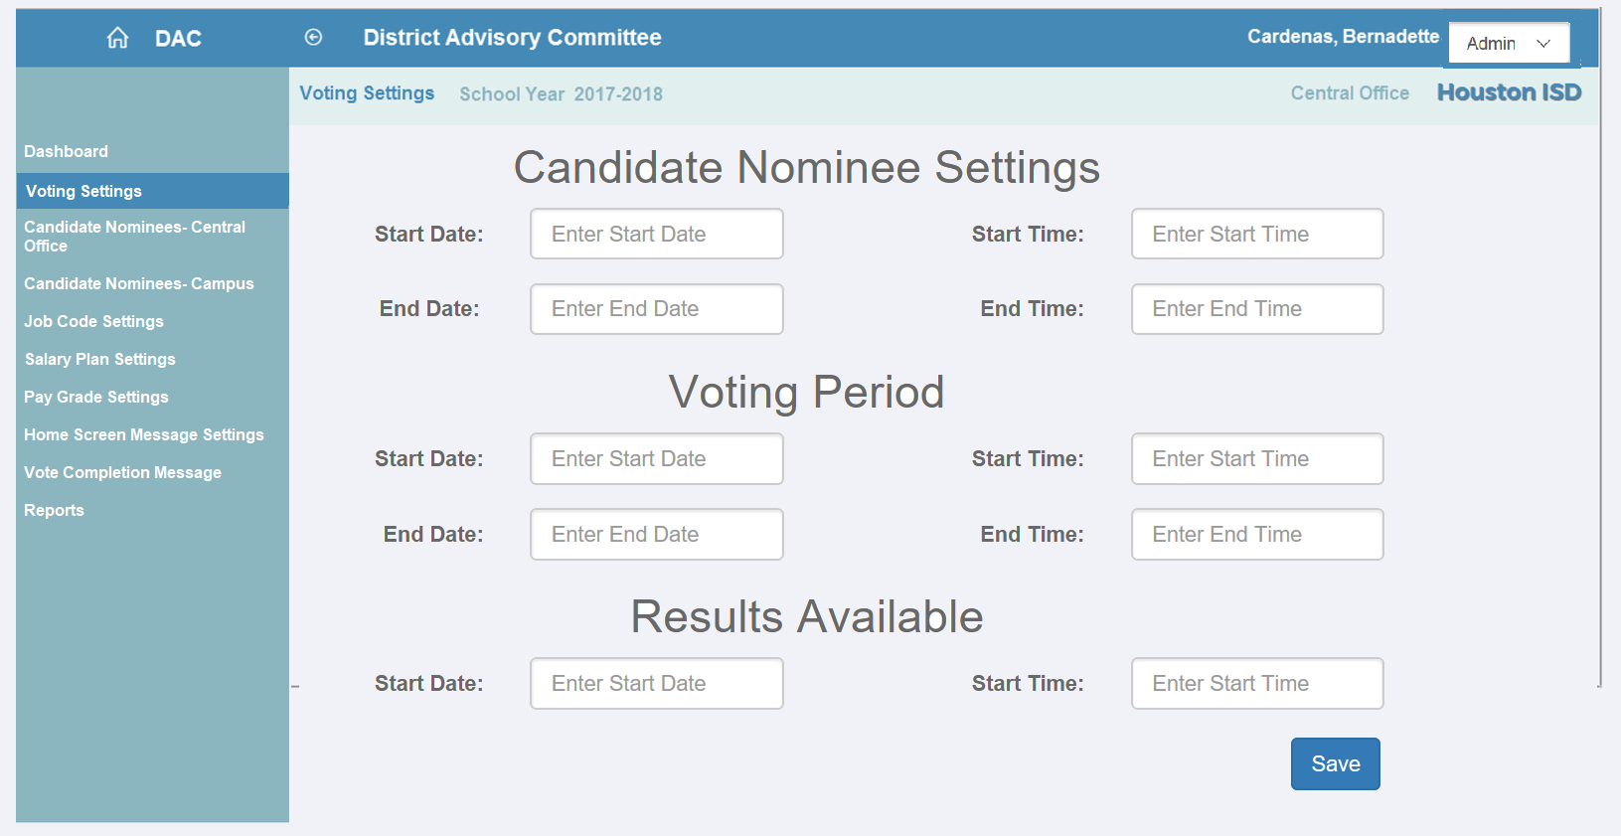
Admin Screen- Voting Settings

Slide 6
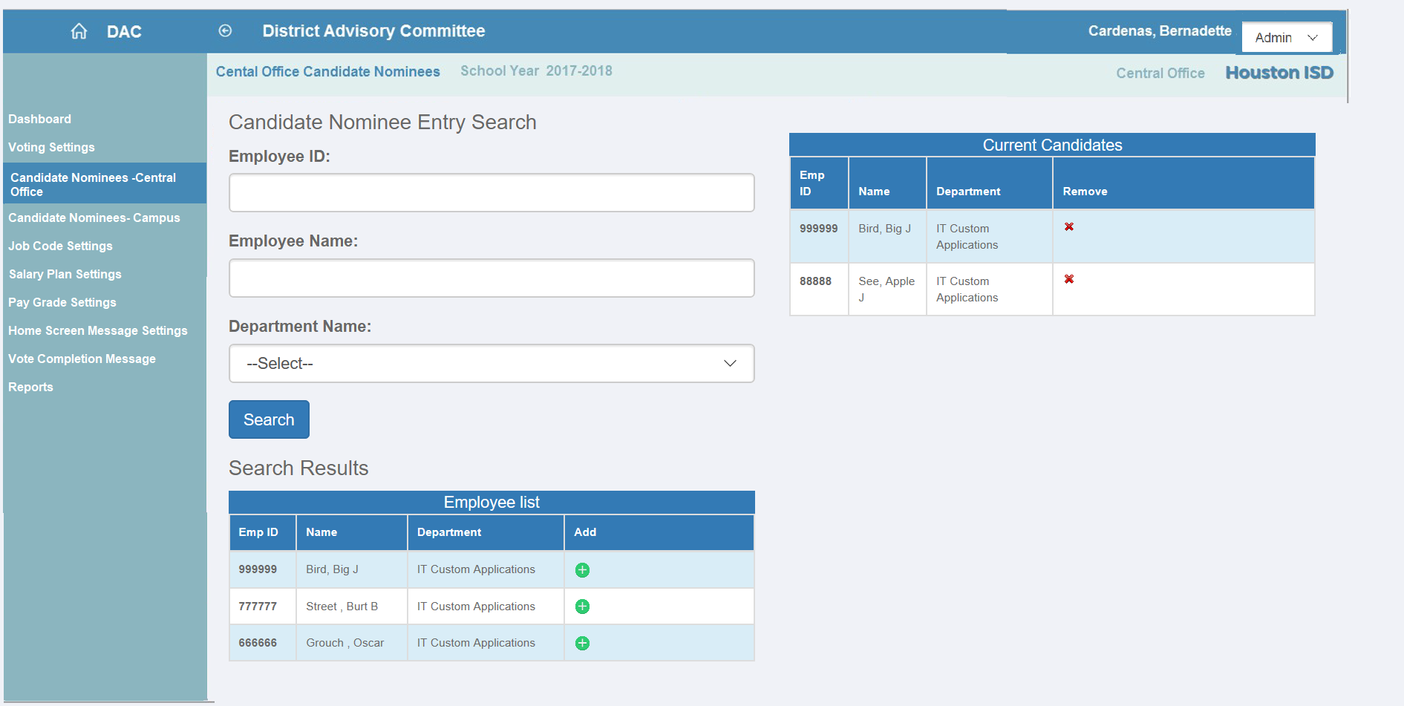
Admin Screen- Candidate Nominees- Central Office

Slide 7
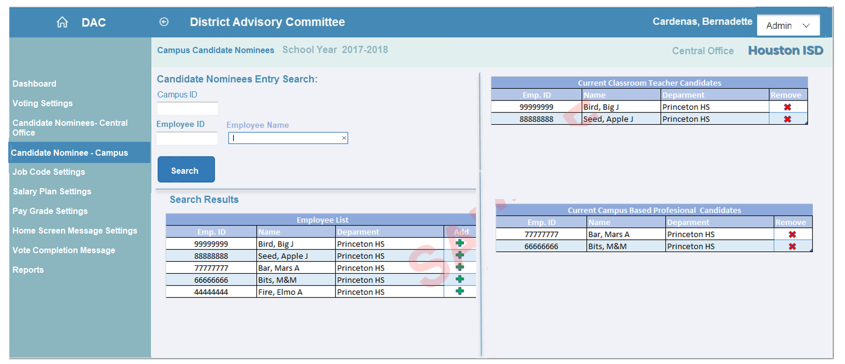
Admin Screen- Candidate Nominees- Campus

Slide 8
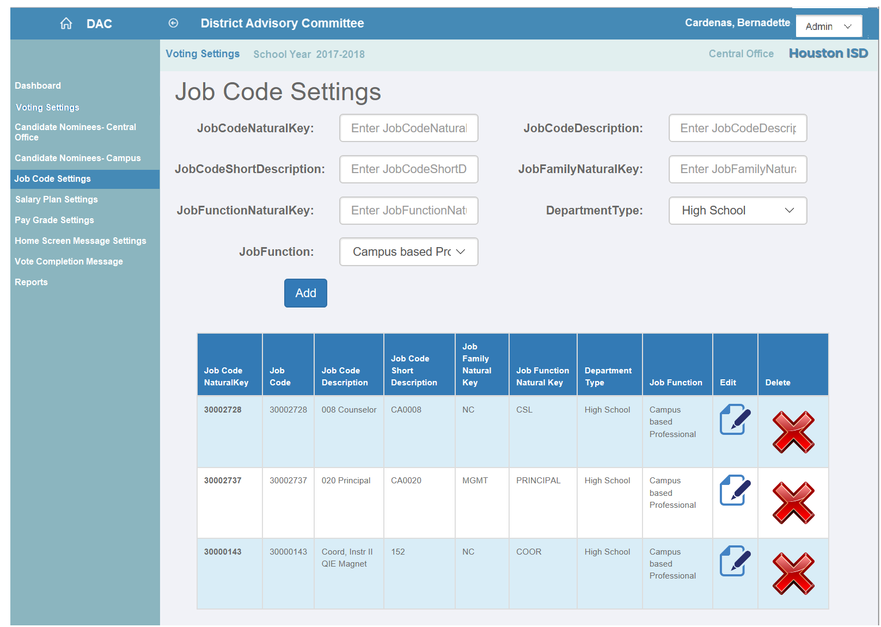
Admin Screen- Job Code Settings

Slide 9
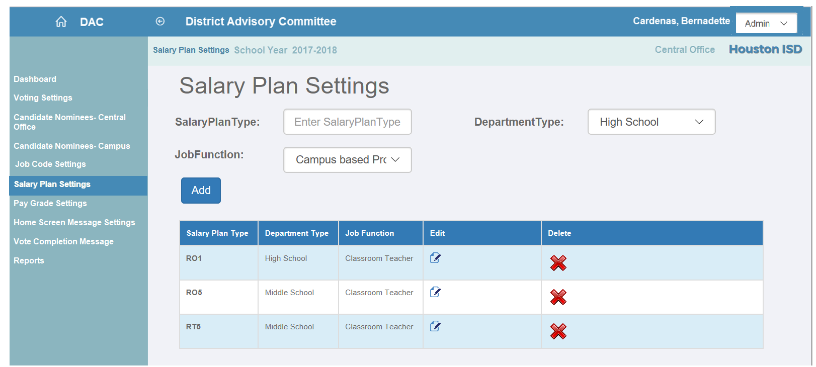
Admin Screen- Salary Plan Settings

Slide 10
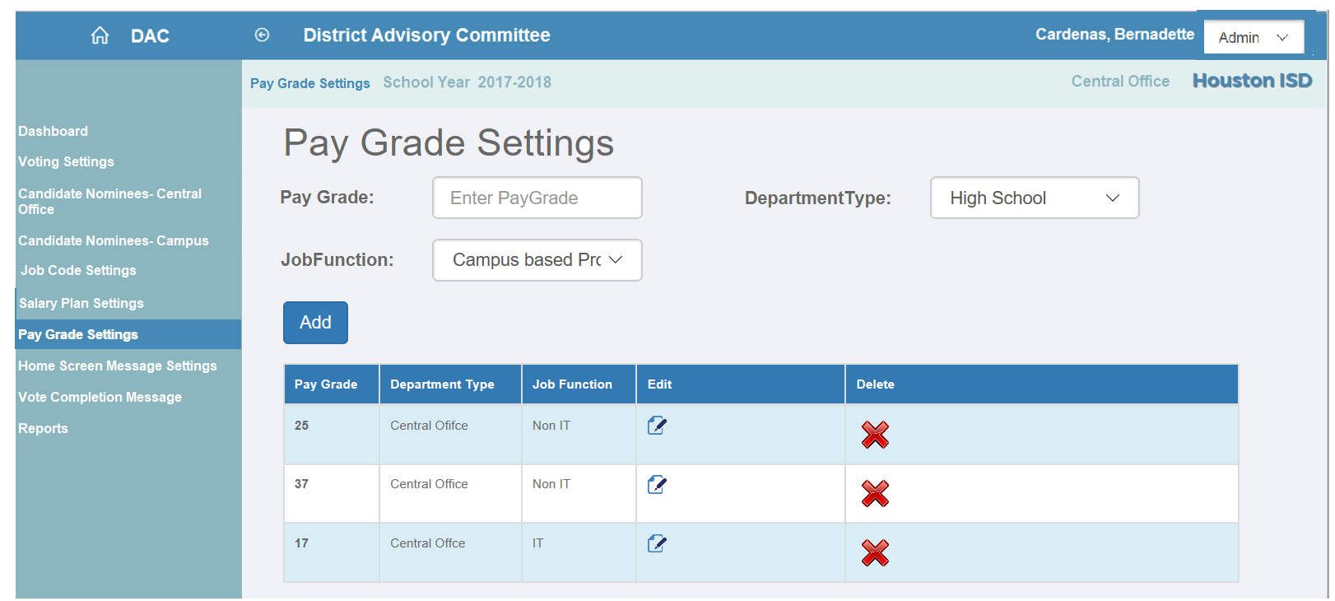
Admin Screen- Pay Grade Settings

Slide 11
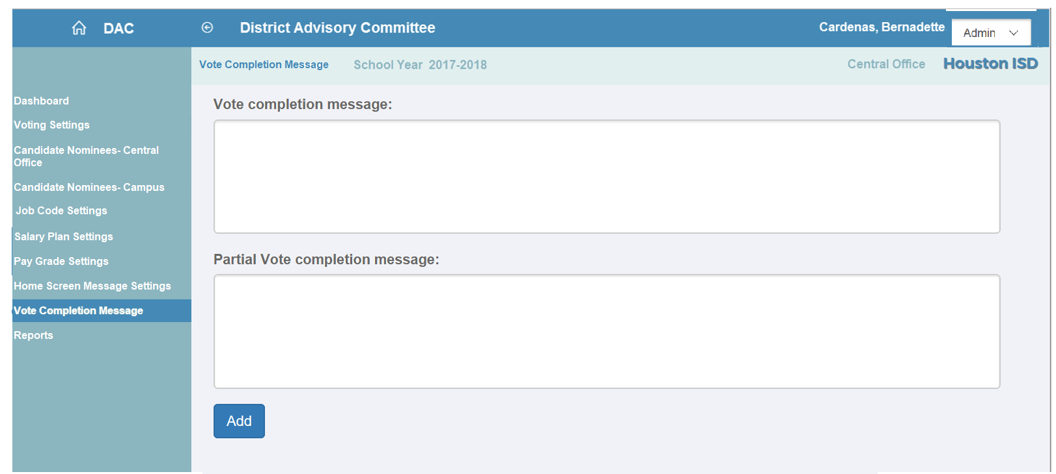
Admin Screen- Vote Completion Messages

Slide 12
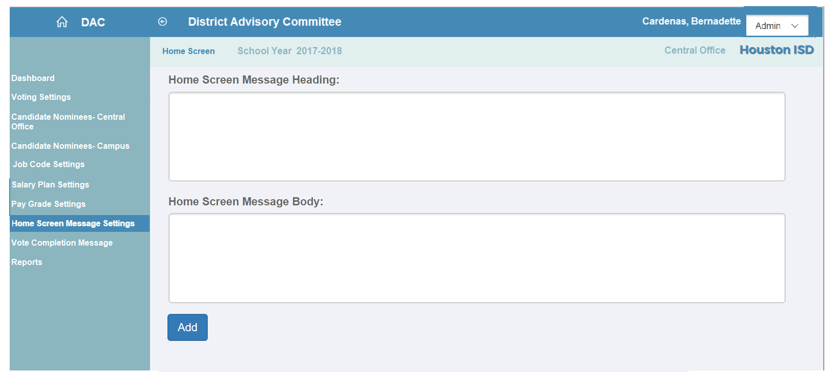
Admin Screen- Home Screen Message

Slide 13
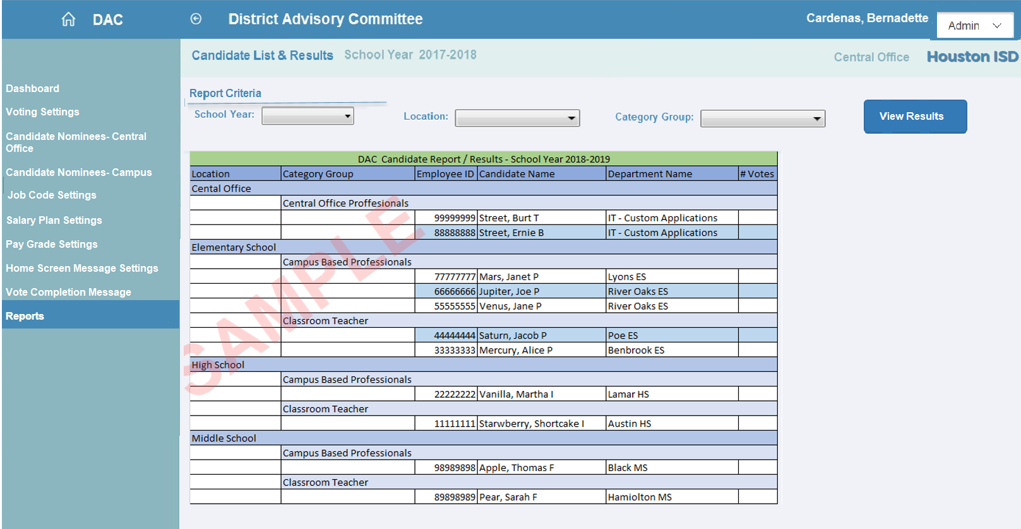
Admin Screen- Reports

Slide 14
Principal and DAC_SC Screens

Slide 15
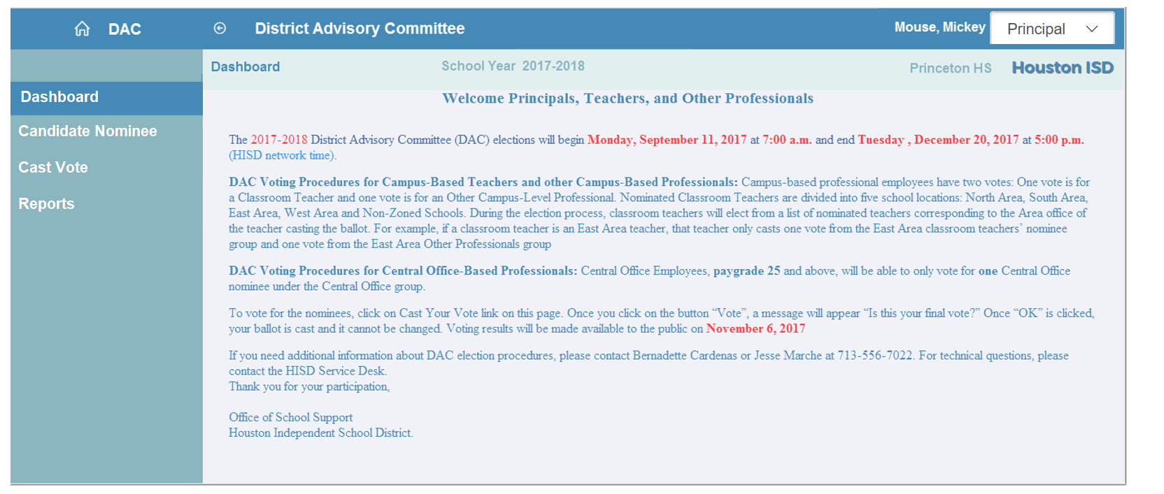
Principal Screen- Dashboard

Slide 16
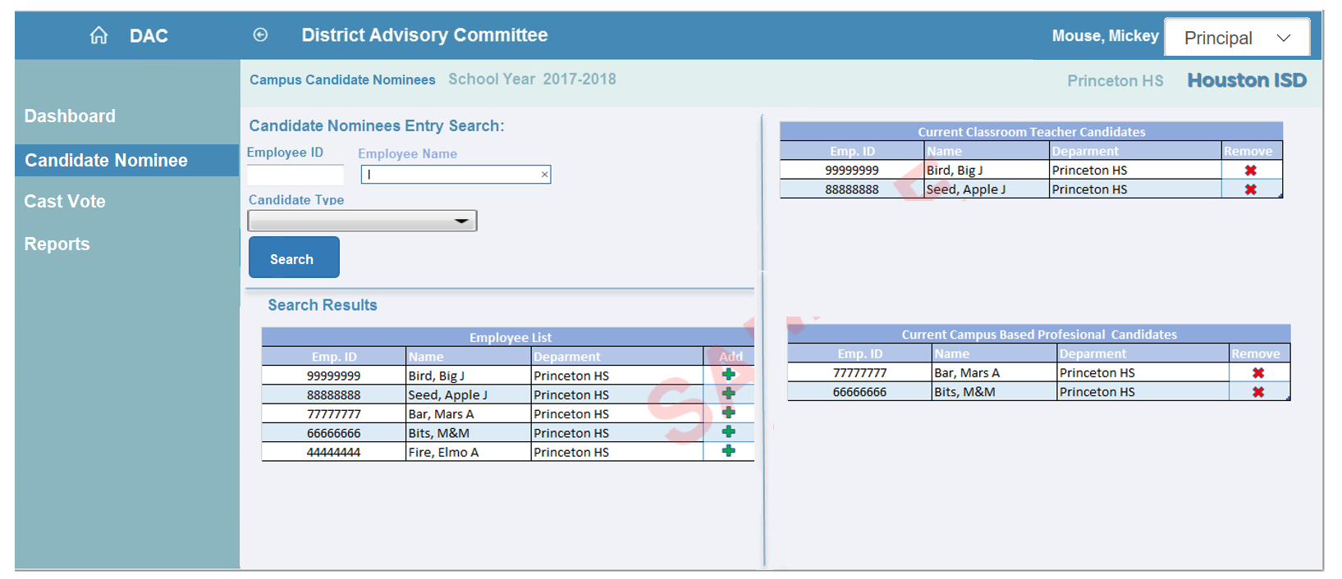
Principal Screen- Candidate Nominee

Slide 17
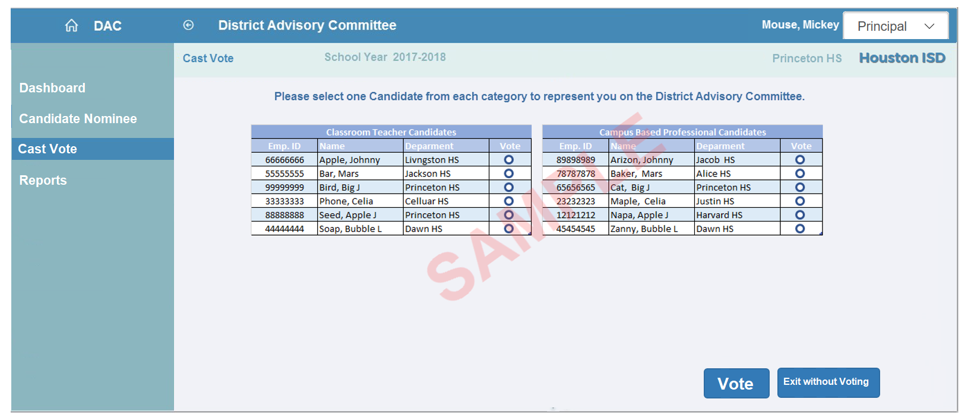
Principal Screen- Cast Vote

Slide 18
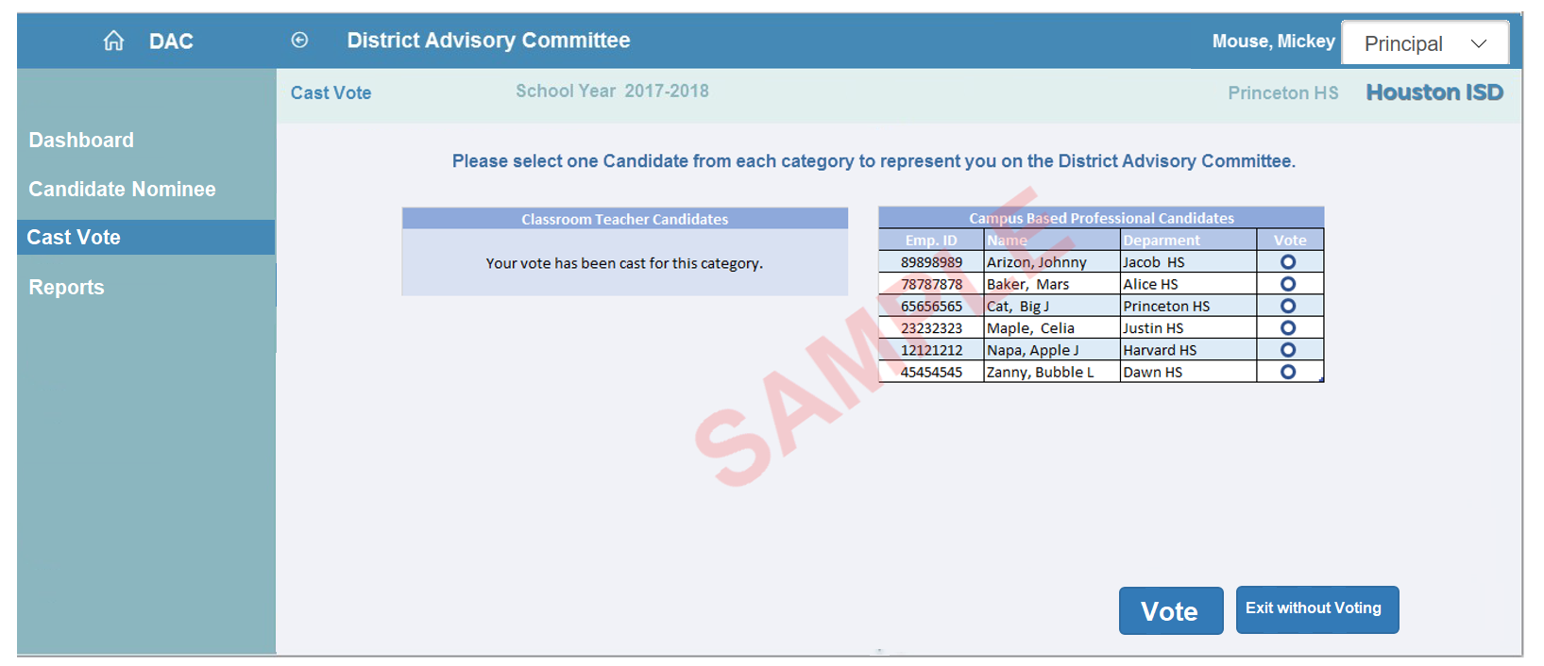
Principal Screen- Cast Vote

Slide 19
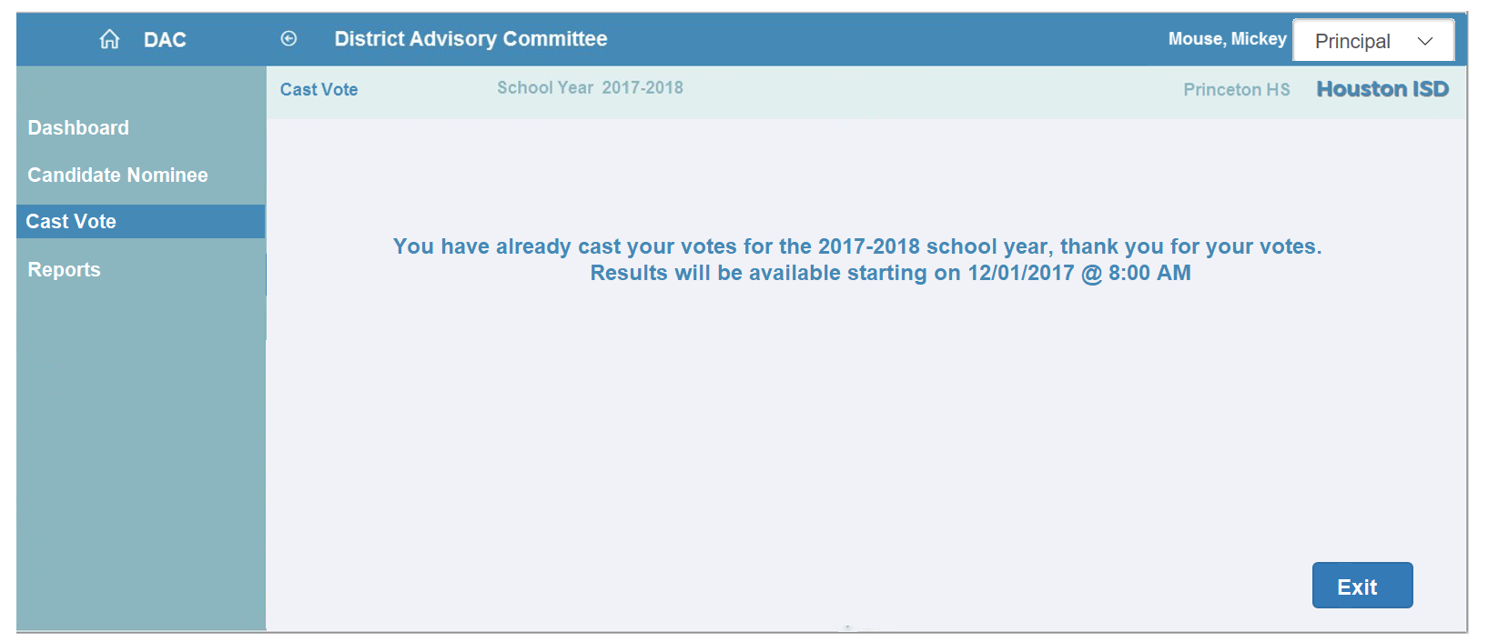
Principal Screen- Cast Vote

Slide 20
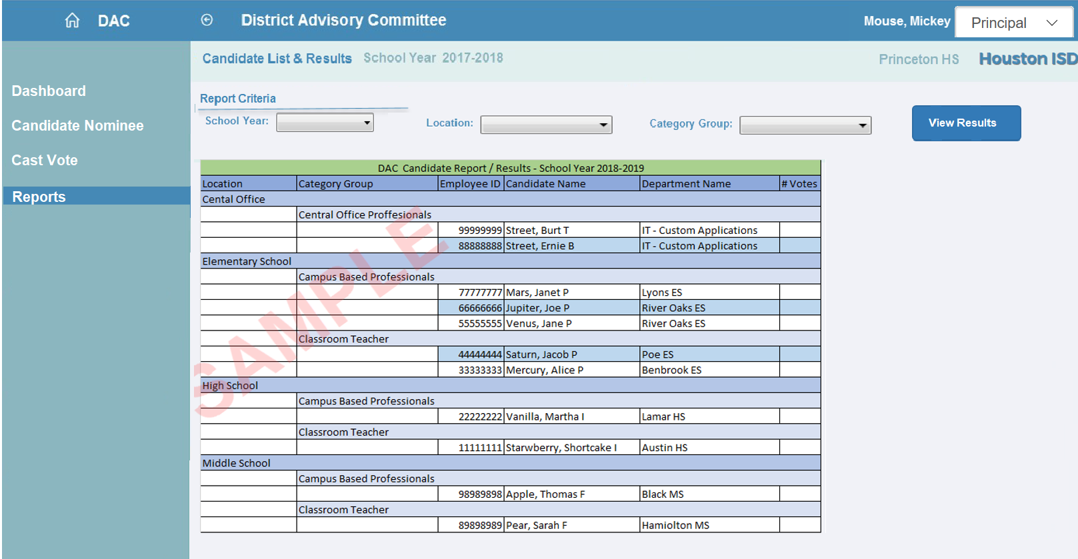
Principal Screen- Reports

Slide 21
Campus Based Employees

Slide 22
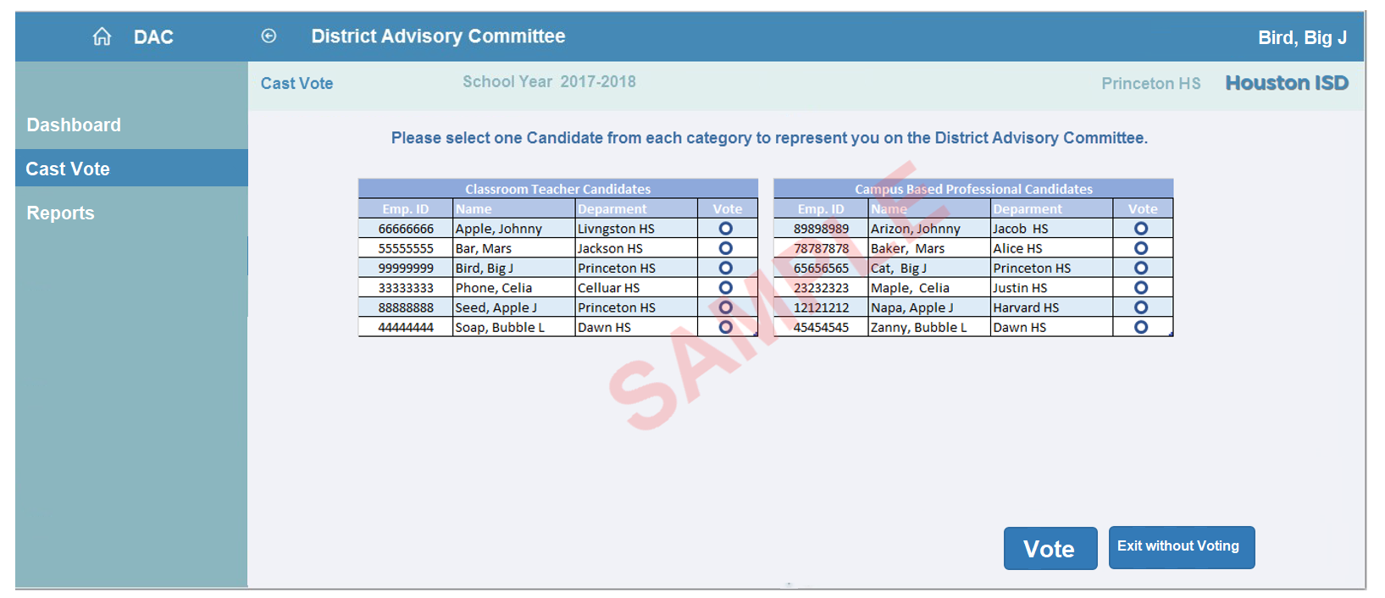
Campus Based Employees-Cast Vote

Slide 23
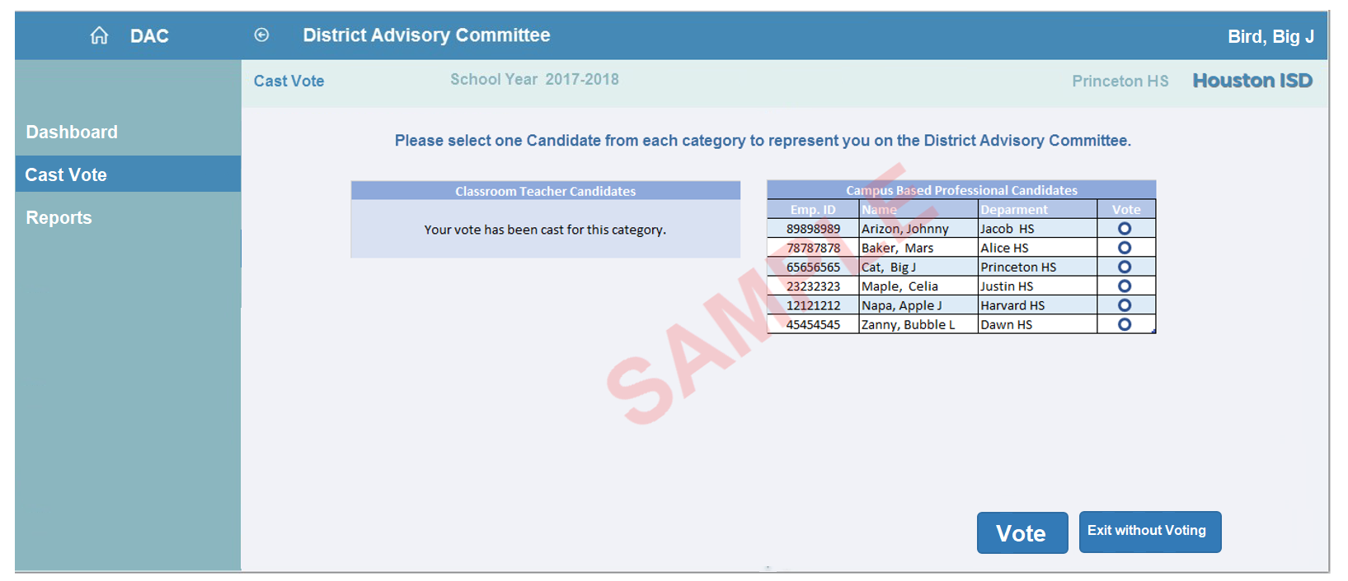
Campus Based Employees-Cast Vote

Slide 24
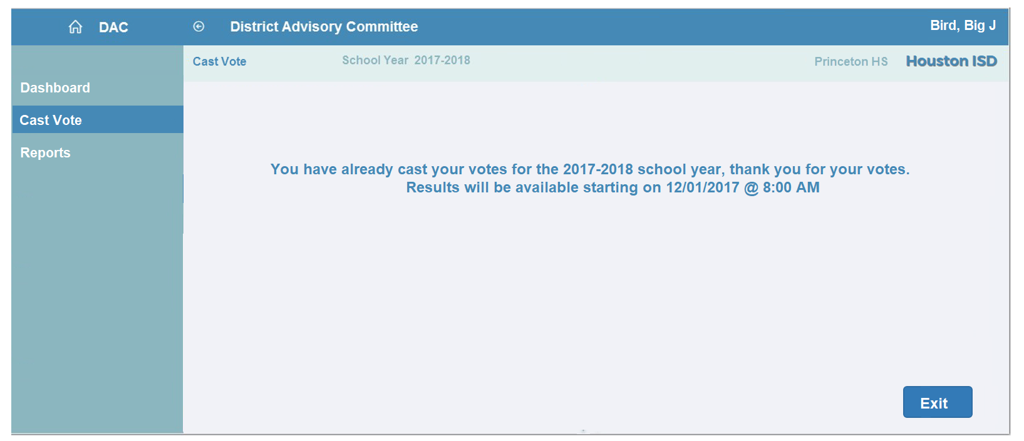
Campus Based Employees-Cast Vote

Slide 25
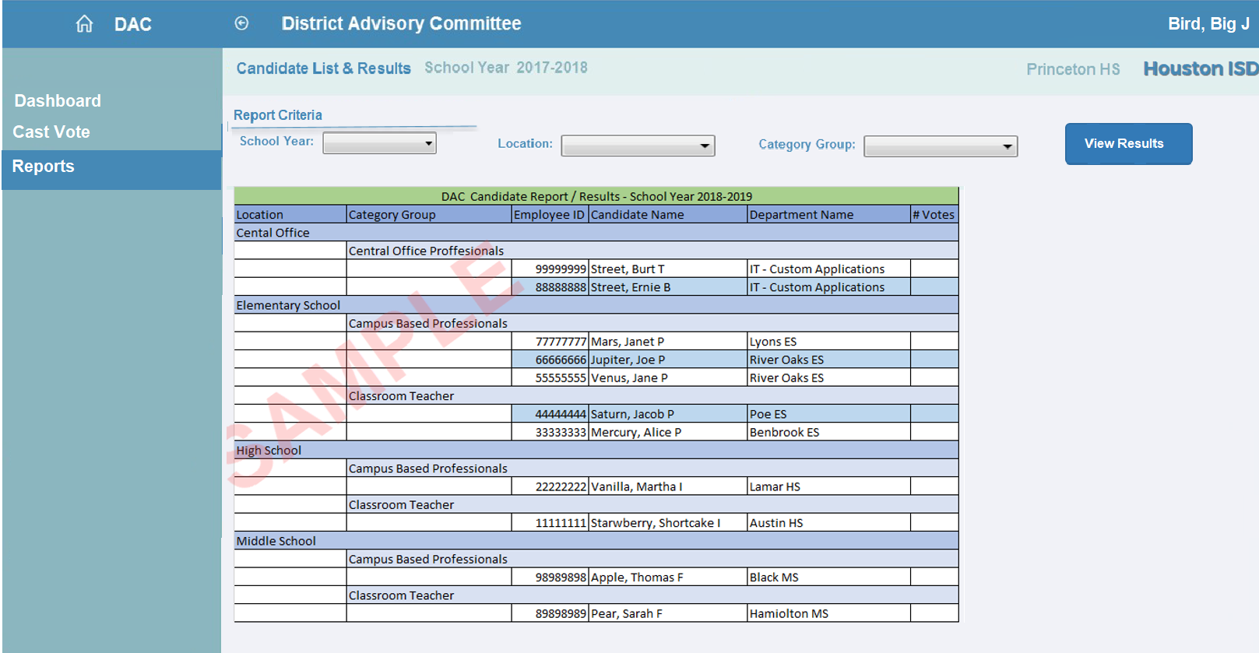
Campus Based Employees-Reports

Slide 26
Central Office Employees

Slide 27
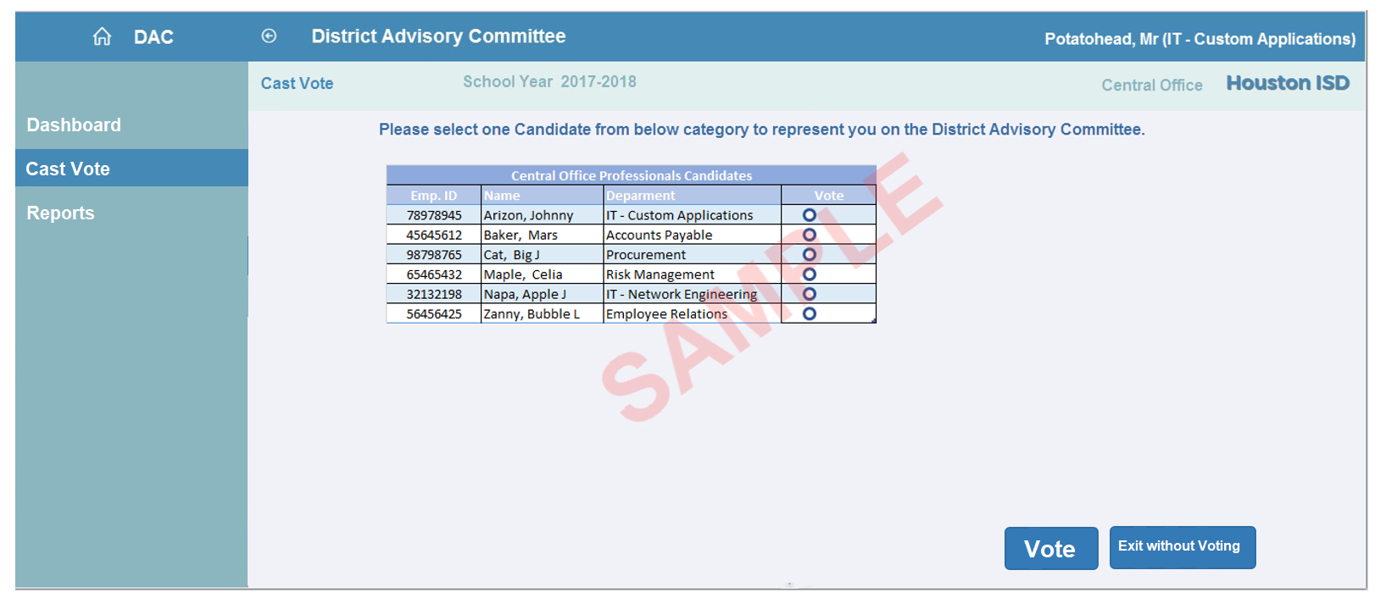
Central Office Employees-Cast Vote

Slide 28
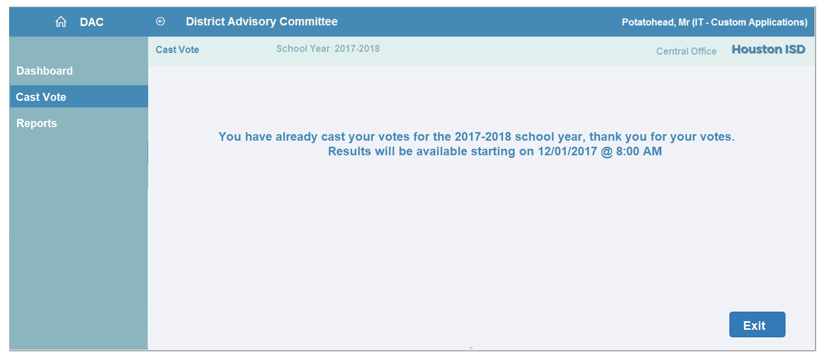
Central Office Employees-Cast Vote

Slide 29
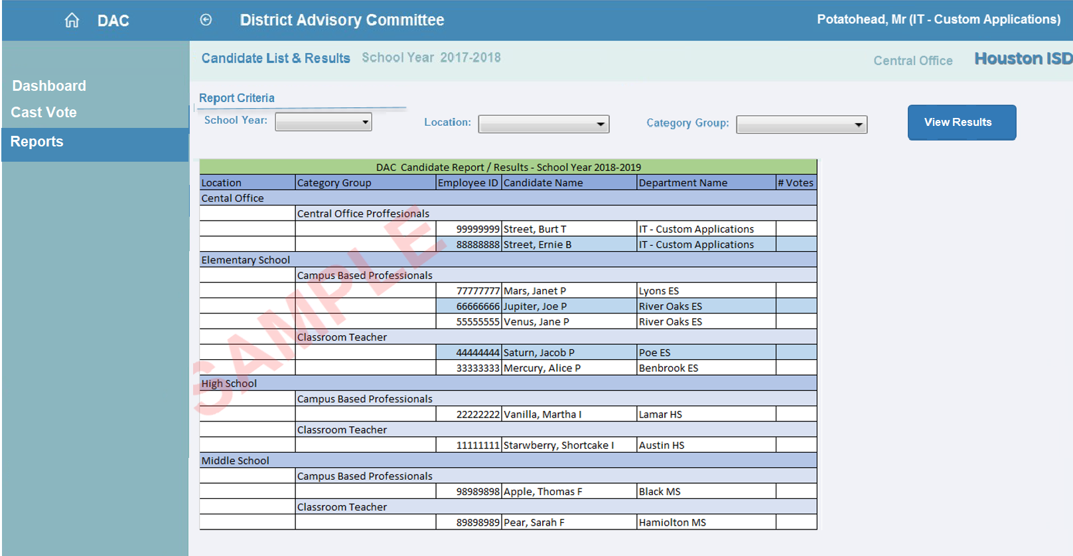
Central Office Employees-Reports

